Slide 1
Project: Virtual Job Fair Students: Justin Korah, Diego Perez, Andres Gonzalez, Enmanuel Corvo, Tomer Doar Mentor: Masoud Sadjadi, Juan Caraballo
Project Presentation
CIS 4911 Senior Project
School of Computing and Information Sciences
Florida International University
04/23/2013

Slide 2
Problem
Recruiters everywhere are always looking for talent at the college level to fill in internship and entry level roles.
Physical Interaction
Currently the most effective way for employers to recruit at schools is to visit them and set up presentations or attend career fairs at the school.
Unfortunately, not all companies have the resources and the time available to visit a substantial amount of schools
Virtual Interaction
Universities have provided Career Sites that enable employers to post jobs along with contact info, so that students can apply.
Employers are not able to virtually interview a student
Employers are not able to look at student profiles, proactively searching for talent in their own time
Students do not get notified of new job postings

Slide 3
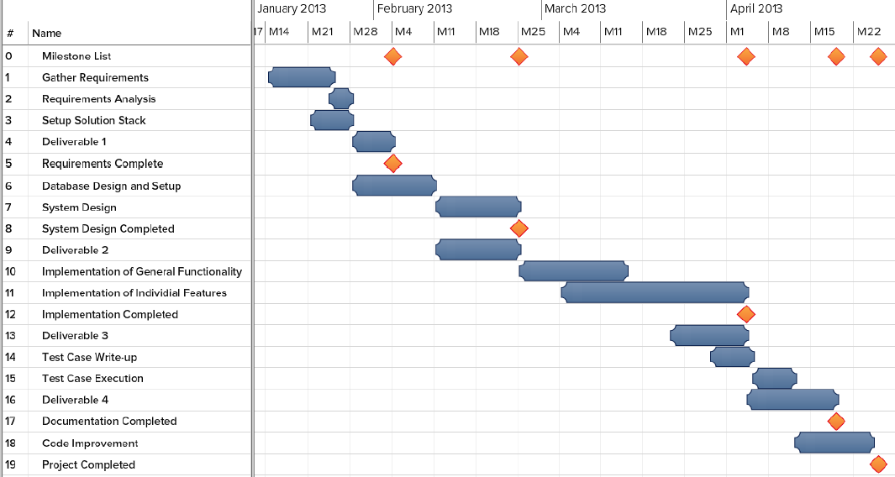
Schedule

Slide 4
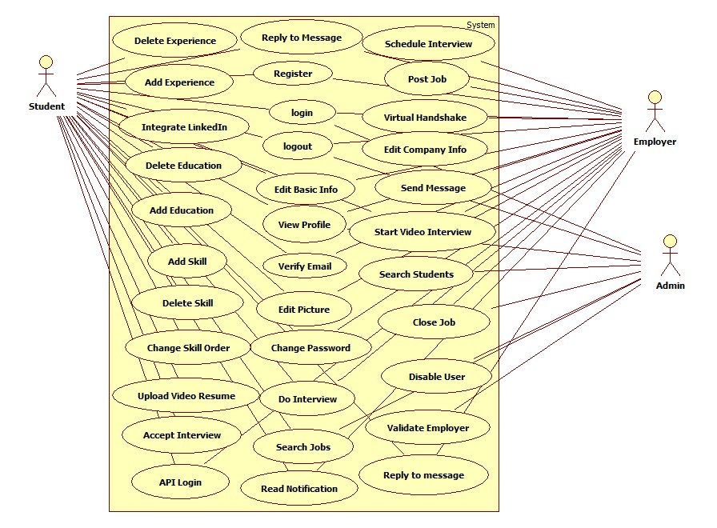
Use Cases

Slide 5
Functional Requirements
Use Case ID VJF-0019 Integrate LinkedIn to Profile
Description Get user information from LinkedIn
Actor Student
Preconditions
User is on Virtual Job Fair Site
User is logged in
Steps
User clicks My Profile Link
User is redirected to his profile page
User clicks on ‘LinkedIn Connect’ link
User is redirected to page where prompted for username and password for LinkedIn
User enters username and password for LinkedIn and clicks continue.
User is redirected to My Profile with complete information from LinkedIn
Post-conditions User profile is built
Exceptions User cancels the action
Non-Functional Requirements System should respond within 2 seconds

Slide 6
Functional Requirements
Use Case ID VJF-0020 Video Interview
Description Video Interview
Actor Employer, Student
Preconditions
Actors are logged in
Both actors are using Chrome
A video interview has been previously scheduled
A notification for the video interview was sent to both parties and it is displaying in the homepage
Actors are in homepage
Steps
Actor clicks on link to video interview in the notifications window in homepage
Actor is redirected to the video interview page where he/she sees to the left the video connection tools and the video window, and to the right the other party’s profile
Once the employer is ready to start the interview he/she clicks on the start button
Once both parties are connect the video interview is started
Once the interview is finish, the employer and student clicks the hang-up button to be disconnected
Post-conditions Both parties participated in a video interview
Exceptions Actor is not using Chrome, system will warm him/her that they need chrome for the video interview to work properly
Non-Functional Requirements System should respond within 2 seconds

Slide 7

System Design
MVC – Passive View:
MVC – Passive View:
1-HTTP Request
Yii Router
7 – HTML
2-Action
5-Invoke
View
Controller
3-Call
Model
6-HTML
4-Send Content

Slide 8
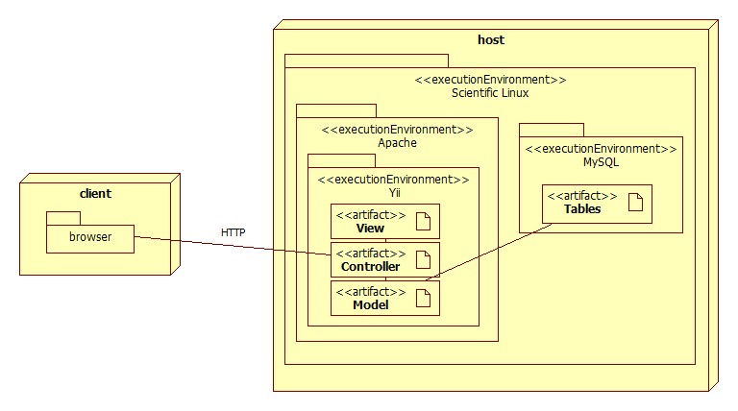
System Design

Slide 9
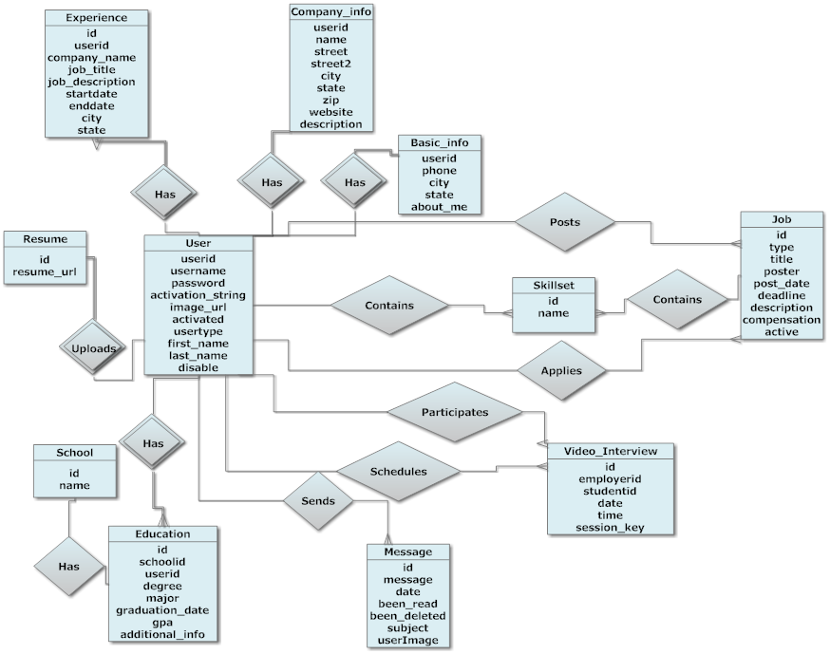
Database Design

Slide 10
Security and Privacy
Security
User password will be hashed before it is stored in the database.
Cross-site Scripting Prevention
Administrator will be able to disable users and delete jobs
Only an employer that has been checked by admin will be able to have a profile
Privacy
Yii access control rules
Who can see what data, who can do what actions
Student will be able to message employer only if the employer gives permission
Employers will be able to hide their contact information on their profiles

Slide 11
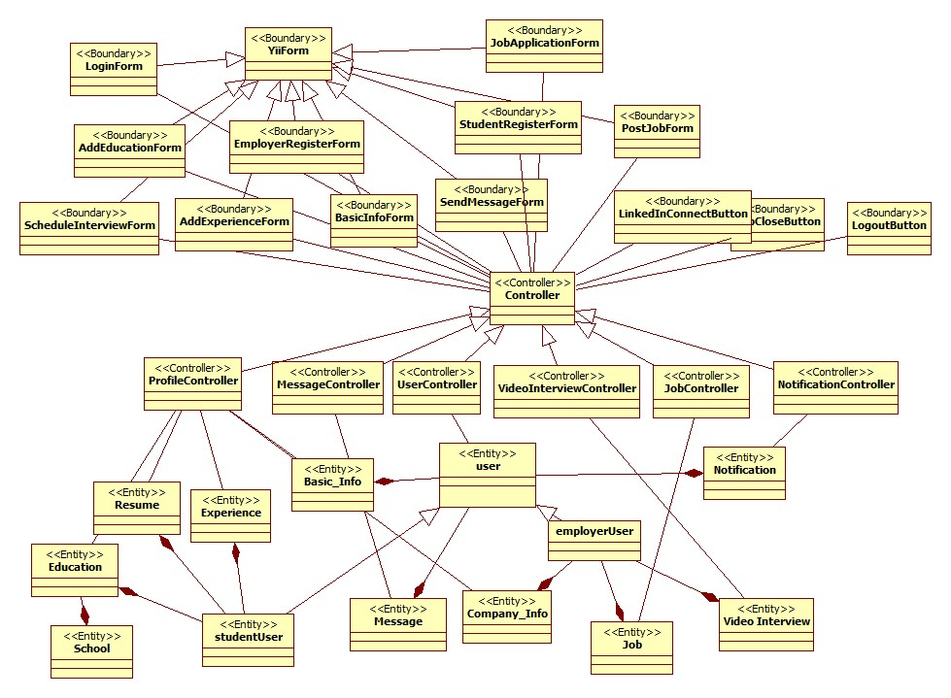
Minimal Class Diagram

Slide 12
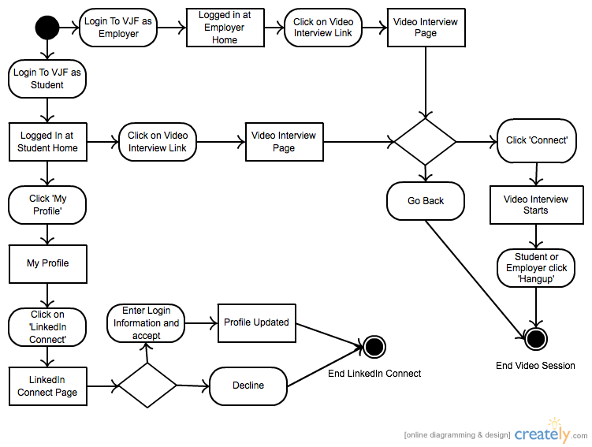
Detailed Design

Slide 13
System Testing Sunny Day
Test ID VJF-0020 LinkedIn Connect Sunny Day
Purpose
Cover Sunny Day scenario to integrate a LinkedIn profile to a student profile
Preconditions
Student is logged into the Virtual Job Fair sire
Student is at home page
Input
Student clicks on ‘My Profile’ link
Student clicks on ‘LinkedIn Connect’ link
Student enters user credentials for LinkedIn and clicks continue
Expected Output
User profile is updated with complete profile information (Basic Information, Experience, Education and Skills) from LinkedIn

Slide 14
System Testing Rainy Day
Test ID VJF-0020 LinkedIn Connect Rainy Day
Purpose
Cover Rainy Day scenario to integrate a LinkedIn profile to a student profile
Preconditions
Student is logged into the Virtual Job Fair site
Student is at home page
Input
Student clicks on ‘My Profile’ link
Student clicks on ‘LinkedIn Connect’ link
Student enters incorrect user credentials for LinkedIn and clicks continue
Expected Output
User is informed that login information is incorrect

Slide 15
Questions?

